Slide 1
Data Processing: RFID
NC 812/ESD 812
Ref: Adaptive Cleaning of RFID Streams, S. Jeffrey et al, UC Berkeley
Leveraging Spatio-Temporal Redundancy for RFID Data Cleansing, H Chen et al

Slide 2
Smart environment: Dimensions
Privacy
Security
Decision Making, Rule Engine
Information from the Data
Prediction, Data Mining etc.
Communication: Local and to the cloud
WSN
Hardware: Sensors and Actuators

Slide 3
Smart environment: Dimensions
Privacy
Security
Decision Making, Rule Engine
Information from the Data
Local Communication: RFID link
Could: Ethernet
Hardware: RFID and Reader

Slide 4
Reader Frequencies
The RFID readers can be classified on the frequency of operation, such as Microwave frequency, UHF (Ultra-high frequency), HF (High frequency) and LF (Low frequency) in the range of 5.8 GHz to 125 KHz.
The costs are also reliant on their range; Microwave frequency readers are costliest, LF readers are the cheapest.

Slide 5
Reader Frequencies
Low frequency
Low frequency (LF) RFID operates at less in 125 to 134.2 KHz frequency, as well its read range is limited to less than a foot (0.33 meter). This frequency is typically used for short range RFID applications. LF tags use less power.
High frequency
High frequency (HF) RFID operate in MHz range. Commonly used frequency is 13.56 MHz and its read range is longer than LF, generally 6-12 inches (medium read range). HF RFID tags are best suited for manufacturing processes and tracking and so on. E.g., library book tracking, Smart Cards.

Slide 6
Reader Frequencies
Ultra-high frequency
Ultra-high frequency (UHF) RFID operates at round 860 MHz to 960 MHz frequency and can read up to 15 feet. They are mainly used for tracking and can offer better range, faster information transfer than LF and HF RFID tags. At this frequency, the radio waves cannot pass through metallic and liquid items.
Microwave frequency
Microwave frequency RFID operates at round between 1 to 5.8 GHz, and can used for relatively longer distance. The electronic toll collection is an example of this tag.

Slide 7
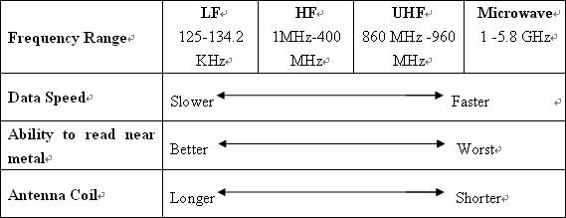
Frequency Range

Slide 8
Characteristics of rfid Data
RFID tags used in the supply chain (which will be used in our smart warehouse) are encoded with an Electronic Product Code, or EPC, which is a globally-unique identifier for the object being tagged.
There are a number of different encoding formats; and to ensure that each EPC is unique, EPCglobal (the organization driving standards for EPC) assigns each company a unique manager number. Each company is then responsible for assigning the other fields required by the encoding format being used.

Slide 9
Characteristics of rfid Data
RFID readers typically return the raw HEX or binary representation of an EPC, values which must then be decoded using bit-level programming to derive a useful representation of the information that a tag holds.
The read must be decoded programmatically according to the EPC specification to extract the decimal field values, and formatted to return a meaningful representation of the EPC called the Uniform Resource Identifier (URI) representation.

Slide 10
RFID Data
Data collection problems
False readings, i.e., read unexpected tags
Duplicate readings, e.g., same reader reading many times, multiple readers reading the same tag
Missed readings, i.e., tags undetected due to RF interference, or malfunctions of tags or readers
High speed and large volume, e.g., many tags present to many readers

Slide 11
RFID Data
Typically small data in 100s of bits from each tag.
Operating in low SNR conditions due to power constraints at the tag
High probability of collision.

Slide 12
RFID Data
Unreliability of the data streams produced by RFID readers can result in upto 30% drop rate.
To compensate, most RFID middleware systems provide a “smoothing filter”, a sliding-window aggregate that interpolates for lost readings.
Typically, these middleware systems require the application to fix the size of the smoothing window in order to produce clean RFID data. Window-size window must be large enough to smooth lost readings but small enough to accurately capture tag movement.

Slide 13
Example Scenario
Passive tags store a unique identifier code (e.g., a 64 or 96-bit ID for EPCGlobal tags). 915 MHz technology provides a range of roughly 10-20 feet and is typical of supply chain management applications.
Readers interrogate and tags in the area respond to these signals with their unique identifier code. An interrogation cycle is one iteration through the reader’s protocol that attempts to determine all tags in the reader’s vicinity.
The results of multiple reader interrogation cycles are grouped into epochs. An epoch may be specified as a number of interrogation cycles or as a unit of time. A typical epoch range is 0.2-0.25 seconds.

Slide 14
Reading Accuracy
For each epoch, the reader keeps track of all the tags it has identified, as well as additional information such as the number of interrogation responses for each tag and the time at which the tag was last read. Readers store this information internally in a tag list which is periodically transferred to readers’ clients.

Slide 15
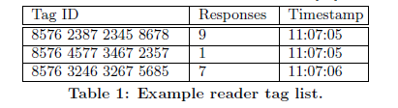
Reader Tag List

Slide 16
Example: RFID Reader and Tag Performance
Two RFID readers with three types of tags in two environments were profiled.
A single tag was suspended at varying distances in the same plane as the antenna. For every 6-inch increment of distance from the reader, the read rate (number of responses to interrogations) was measured for 100 epochs.
First environment is a large, wide open room with little metal present, represents a controlled environment for RFID technology.
Second profiling environment is a lab with metal objects such as desks and computer equipment, represents a noisy environment.

Slide 17
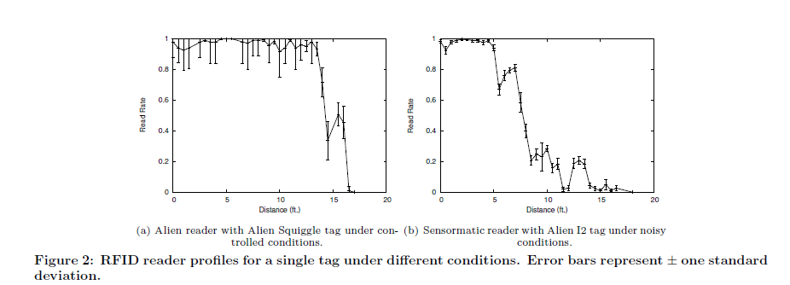
Reader Performance

Slide 18
Major and Minor Detection Regions
The overall detection range of all readers and tags profiled remains relatively constant at 15-20 feet.
Within each reader’s detection range, there are two distinct regions:
(1) The area directly in front of the reader, termed the reader’s major detection region, giving high detection probabilities (read rates at or above 95%);
(2) The reader’s minor detection region, extending from the end of the major detection region to the edge of the reader’s full detection range, where the read rate drops off linearly (with some variation) to zero at the end of the detection range.

Slide 19
Detection Region
Difference between observed profiles lies in the percentage of the reader’s detection range corresponding to its major detection region.
In a less noisy environment, the major detection region corresponds to roughly 75% of the full detection range for the profile whereas it makes up only 25% of the range in the profile in noisy environment.

Slide 20
RFID Data
Given the inherent unreliability of RFID readings, it can be seen that observed RFID data streams typically do not provide a complete, authoritative picture of the true population of tags in the physical world.
Especially for tags outside a reader’s major detection region, several readings may be missed, causing some tags to become “invisible” during a time window. These errors imply that only a subset of the tag population is actually observed.

Slide 21
RFID Data
Lack of readings from a tag may not be due to missed readings but rather because the tag moved out of the detection field. The inherent tension between completeness of readings and capturing tag dynamics (i.e., signal transitions) only exacerbates the problem.
Signals with a high degree of variability require short smoothing windows to capture rapid changes in the measurement data; but, obviously, a smaller window leads to more missed readings and more severe and systematic underestimation.

Slide 22
Data Redundancy: Opportunities
Data redundancy introduced by overlapping detection regions of multiple stationary readers (spatial redundancy) or continuous readings over time of a single mobile reader (temporal redundancy) to improve reading accuracy.
Prior knowledge about tagged objects and RFID readers to improve reading accuracy.
Constraints in target applications (e.g., the maximal capacity of a room or a shelf) to cleanse the data.

Slide 23
Redundancy
Two types of redundancy may arise in RFID related applications: spatial redundancy, where an object is detected by multiple readers in its neighborhood, and temporal redundancy, where an object is detected multiple times by a single reader over time.

Slide 24
Spatial Redundancy
Spatial Redundancy: Many applications employ redundant readers to cover the target area completely to improve localization accuracy. Objects are read by multiple readers simultaneously.
Figure next shows an example of spatial redundancy where the target area is divided into six zones (using one dimensional model) and an RFID reader is located in the center of each zone.
Spatial overlap of readers’ detection regions leads to duplicate readings, i.e., an object is in the detection regions of multiple readers.

Slide 25
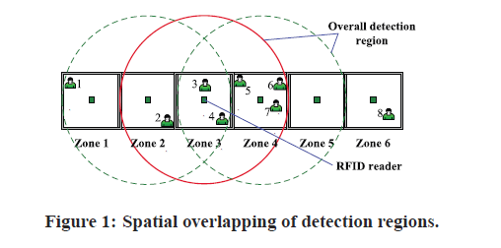
Redundancy

Slide 26
Spatial Redundancy
Object 2 is detected by the reader in Zone 2 and also the reader in Zone 3, which makes it difficult to tell the exact location of Object 2. However, since an object cannot appear in more than one zone at the same time, at least one of the readings belongs to spatial redundancy.
Object 3 is detected in Zone 4 only. However, it does not necessarily mean that Object 3 is in Zone 4 for sure. It is possible that the reader in the zone where Object 3 is located simply failed to detect it.

Slide 27
Spatial Redundancy
On the first look, spatial redundancy causes confusion as it introduces inconsistent information (e.g., about the location of Object 2).
However, a redundant reading may supply the necessary information for the system to derive the location of an object when its intended reader fails to detect it (e.g., Object 3).
Thus, the challenge is how to take advantage of redundancy while avoiding its undesirable effect in data cleansing.

Slide 28
Temporal Redundancy
The same object may be seen by same reader (or different ones) over a period of time.
The temporal redundancy may be used to improve accuracy and detect displacement (if any).

Slide 29
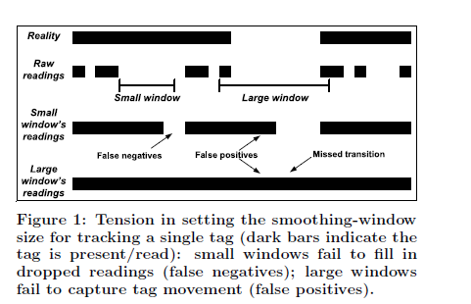
Smoothing Window Size

Slide 30
Window Size
The ideal smoothing-window size needs to carefully balance two opposing application requirements:
ensuring completeness for the set of tag readings (due to reader unreliability) or improving probability of detection (P_{d}) and
capturing tag dynamics (due to tag movements in and out of the reader’s detection field) or reducing the probability of false alarm (P_{f}).

Slide 31
Completeness
Completeness: To ensure that all tags in the reader’s detection range are read, the smoothing window must be large enough to correct for reader unreliability.
Small window sizes cause readings for some tags to be lost, leading to false negatives and, consequently, a large underestimation bias (e.g., always under-counting the tag population).
Adjusting the window size for completeness depends on the reader’s read rate, which, in turn, depends on both the type of reader and tag as well as physical surroundings,

Slide 32
Tag Dynamics
Tag Dynamics: Using a large smoothing window, on the other hand, risks not accurately detecting tag movements within the window, leading to false positives.
It is possible that the window may smooth over one or more tags leaving and returning, thus missing the variation in the underlying “signal”.
Adjusting the window size for tag dynamics depends on the movement characteristics of the tags, which, in turn, depends on the application; for instance, a tag sitting on a shelf exhibits a very different movement pattern from a tag on a conveyor belt.

Slide 33
Mapping RFID Readings to a Sampling Process
An epoch is the atomic unit of detection and is considerably smaller than the expected window size; that is, epochs represent our basic “time units”, many of which make up a smoothing window.
Without loss of generality, let N_{t} denote the (unknown) size of the underlying tag population at epoch t, and let S_{t} ⊆ {1, . . . , N_{t}} denote the subset of tags observed (“sampled”) by the reader during that epoch.

Slide 34
Sampling Probability
S_{t} can be viewed as an unequal probability random sample of the tag population. For each tag i ∈ S_{t}, the response-count information is stored in the reader tag list is used in conjunction with the known number of interrogation cycles per epoch to derive a per epoch sampling probability p_{i,t}.
This sampling probability p_{i,t} is empirically estimated as the observed read rate for tag i during that epoch; Assuming a reader configuration with a total number of 10 interrogation cycles per epoch, the sampling probabilities for the first and second tags in the table would be p_{x78,t} = 0.9 and p_{x57,t} = 0.1, respectively

Slide 35
Reader Tag List

Slide 36
Sliding Window Size
Sliding-window size must be adjusted in a statistical manner based on the probability of occurrence.
Parameter p_{i,t} is the probability that tag i is detected in epoch t. Epochs in the slide windows can be viewed as the result of repeated random-sampling trials which are represented as B(ω_{i} ,p_{i,t}), where ω is the size of slide window.
Each epoch is an independent Bernoulli trial with probability p_{i,t}. The epochs in subset S_{i} (where tag i is seen) imply that the tag is detected by reader in these epochs. The probability that the tag is not read in all epochs is
(1-P_{avg})^{ω} where
P_{avg}= ΣP_{i,t}/|S_{i}|.

Slide 37
Sliding Window Size
The size of slide window will meet the following requirement.
ω>ln(1/δ)/p_{avg}
The δ parameter provides a control variable that allows an application to express its preferences with respect to balancing false positives versus false negatives.
Using a smoothing-window size as suggested above guarantees completeness (i.e., correct detection of tag i) with high probability, it can also lead to missing the temporal variation in the underlying signal (e.g., due to the movements of tag i).

Slide 38
Sliding Window Size
Large smoothing windows can miss signal transitions, where tag i is mistakenly presumed to be present in the reader’s detection range due to the interpolation of readings inside the window.
To avoid smoothing over transitions and producing many false positives, we need to accurately determine when tag i exited the reader’s detection range (as opposed to a period of dropped readings) and decrease the size of its window.

Slide 39
False Detection
Binomial sampling model may be used to detect transitions as statistically-significant deviations in the observed binomial sample size from its expected value.
Assuming the current window size ω_{i} and sampling probability p^{avg} _{i} are not too small, it follows from a Central Limit Theorem (CLT) that, the value of |S_{i}| is within ±2 √Var[|Si|] of its expectation with probability close to 0.98.
Based on this observation, a transition (i.e., exit) for tag i in the current window if the number of observed readings is less than the expected number of readings and the following condition holds:

Slide 40

False Detection

Slide 41
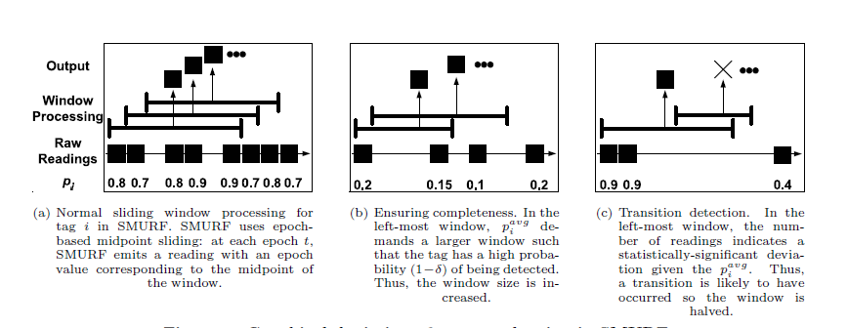
Sliding Window

